Slide 1
English for
International
Communication

Slide 2
奠基篇 Unit 5
Part 4 簡短獨白

Slide 3
奠基篇 Unit 5
題型說明
你會聽到10 組不同形式的一人獨白，常見內容包括演講、會議或研討會的開場白、商場或機場廣播、新聞報導、廣告推銷、導覽介紹等，有些獨白會加圖表。每題組各有三個問題，這一部分的題目出法與Part 3 接近，即獨白內容只能用聽的，而每題的問題和答案都出現在題本中，問題基本上也都是Wh- 問句形式。

Slide 4
奠基篇 Unit 5
題型分析
題型1 | 問主旨或目的 | 例 What is the message/talk mainly about?
題型2 | 問說話者的身份 | 例 Who is the speaker?
題型3 | 問談話的對象 | 例 Who is being addressed?
題型4 | 問事件內容、原因或行動 | 例 What problem does the speaker mention?
題型5 | 要即時作答的細節題 | 例 What time does the event start?

Slide 5
奠基篇 Unit 5
題型分析
題型6 | 推論題 | 例 What does the speaker imply about the product?
題型7 | 題目含will . . . next/last 字眼的題型 | 例 What will happen next/last?
題型8 | 是非題／除外題 | 例 Which of the following statements is (not) true?
題型9 | 問口語說法或句意 | 例 What does the speaker mean by saying “Here is the thing”?
題型10 | 圖表題 | 例 Look at the graphic. Who will be the final performer

Slide 6
奠基篇 Unit 5
解題技巧
因獨白內容較長，很容易會在中途分心或是漏掉重要資訊，因此以下幾項基本應試技巧務必熟練：
1 | 快速瀏覽三個題目及四個選項 | 根據問題及選項中的關鍵字，判斷獨白主題及方向。
2 | 仔細聽介紹句 | 每一題組的介紹句“Questions . . . to . . . refer to the following (talk type).”會有助於進一步幫助你正確判斷主題和獨白情境。

Slide 7
奠基篇 Unit 5
3 | 依序作答 | 題組答題順序有七八成會依照順序問，即問題一的答案會在獨白中最先聽到，接著是問題二，然後才是問題三（同 Part 3 所提「主旨題」則可最後作答）。
4 | 看到細節題立刻作答 | 如前一單元 Part 3 中所提到的，遇到選項較短的細節題應一聽到答案就立刻作答，以免忘記該項細節。
5 | 運用想像力 | 想像自己就是獨白的說話對象（例如：若獨白在機場中或飛機上，就想像自己是搭機的乘客；若是導覽說明，就想像自己是參觀者或遊客），在腦海中描繪影像並融入劇情中，以便增加自己對獨白的注意力及記憶力，進而幫助你正確答題。

Slide 8
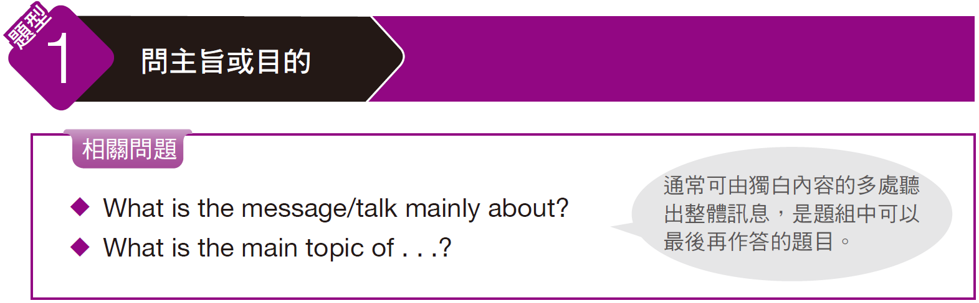
奠基篇 Unit 5

Slide 9

奠基篇 Unit 5
Example
Q: What is the talk mainly about?
(A) Traffic rules
(B) A hotel kitchen
(C) Accommodation rules
(D) A new restaurant
錄音內容
The next question refers to the following talk.
Now, we have certain rules that must be followed. There is no smoking in the rooms and lights must be out by 10 at night. No guests are allowed in the rooms, and breakfast is between seven and nine a.m. There is a kitchen for student use. The fridge is checked four times a day and any food without your name on it will be thrown out. We have food labels available for you in the kitchen. If you have any problems or questions, don’t hesitate to ask.

Slide 10
奠基篇 Unit 5
解析
題目問整段內容的主要訊息。由獨白中的關鍵句 we have certain rules that must be followed「我們有一些必須要遵守的規則」、lights must be out by 10 at night「晚上十點前必須熄燈」、There is a kitchen for student use.「有一個供學生使用的廚房。」等可判斷這段獨白是關於學生住宿的相關規定，故答案選 (C)「住宿規定」。
中文翻譯
我們有一些必須要遵守的規則。室內禁煙，晚上十點前必須熄燈。訪客不得進入室內，早餐於七點至九點之間供應。有一個供學生使用的廚房。冰箱每天檢查四次，所有沒有標上姓名的食物都會被丟棄。廚房內有食物標籤供你們使用。如果有任何問題，可以儘管問我。

Slide 11
奠基篇 Unit 5
Exercise
Listen to the audio track. Answer the following question about what the speaker says in the talk.
Q: What is the main topic of this speech?
(A) University enrollment in developed countries
(B) The gap between the developed and developing world
(C) Academic knowledge of graduate students
(D) Universities in the developing world

Slide 12
奠基篇 Unit 5
Audio Transcripts
The next question refers to the following speech.
Good evening, ladies and gentlemen. I’m here to discuss what we can do to reverse the widening of the financial gap between developed and developing countries. I’d like to draw your attention to the graph on page seven of your text. This graph clearly illustrates the recent sharp decline in university enrollment in developing countries. Top students from these countries often apply for admission to university programs in more affluent nations. There are negative consequences here that need to be addressed. When the best and the brightest students from developing nations go abroad to study, they often stay and seek employment upon graduating instead of bringing their academic knowledge back to their home countries. Thus, the gap between the developed and the developing world will continue to widen, unless something is done to reverse this phenomenon.
• enrollment (n.) 登記；入會（人數） • affluent (adj.) 富裕的
• phenomenon (n.) 現象

Slide 13
奠基篇 Unit 5
中文翻譯
各位先生、女士們，晚安。今天我要來討論我們能做些什麼來逆轉已開發國家和開發中國家之間日益擴大的財政差距。我要請大家看看文件第七頁的圖表。這張圖表清楚展現出最近開發中國家在大學入學數據方面急速下滑的現象。這些國家的頂尖學生經常會到較為富裕的國家申請就讀大學課程。這麼做會產生負面的後果，有必要加以解決。當來自開發中國家最優秀、最聰明的學生前往國外就讀時，他們在畢業時通常會留下來找工作，而非帶著他們的學術知識回到祖國。因此，除非採取一些措施來逆轉這種現象，否則已開發和開發中國家之間的鴻溝將繼續擴大。

Slide 14
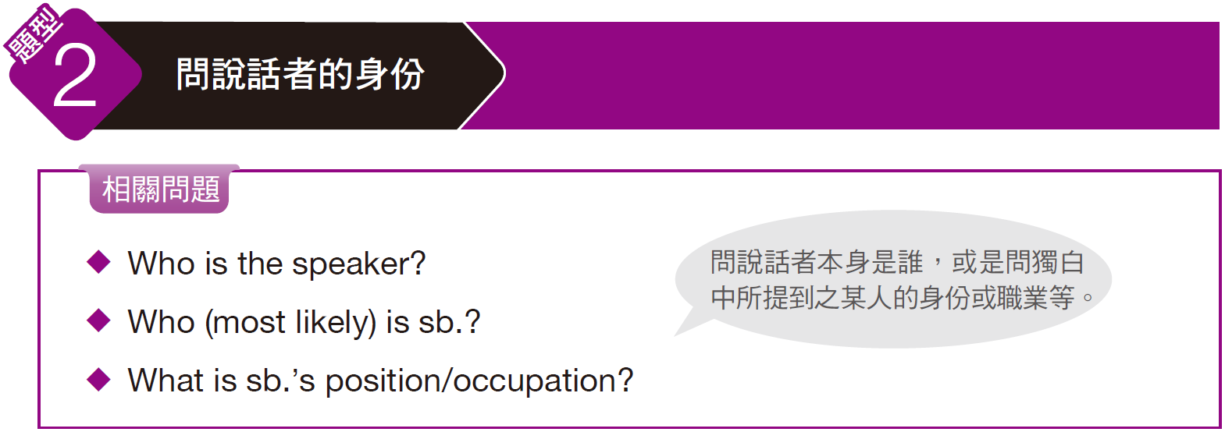
奠基篇 Unit 5

Slide 15
奠基篇 Unit 5
Example
Q: Who is the speaker?
(A) A bus driver
(B) A news reader
(C) A police officer
(D) An actor
錄音內容
The next question refers to the following news report.
We’ve just had a report of a serious traffic jam on the M6 Highway between junctions six and nine. Apparently, there has been an accident involving a bus and a chemical truck. Fire crews are currently at the scene trying to remove the chemical spillage. If you are traveling on the M6, you should expect delays of between one and two hours. Firefighters warn that these chemicals are hazardous and motorists should roll up their windows so as not to breathe in the fumes. And for you smokers, please do not throw cigarette butts out your window, since these chemicals are highly flammable. And now on to today’s weather report. In the afternoon there will be light showers, but skies will clear up in the evening.

Slide 16
奠基篇 Unit 5
解析
題目問說話者的身份。由獨白中的關鍵句 We’ve just had a report of a serious traffic jam on . . .「我們剛收到一則關於在……嚴重堵車的報導」、And now on to today’s weather report.「現在到了今天的氣象時間。」等可知說話者在報導交通路況及氣象，故答案選 (B)「新聞播報員」。
中文翻譯
我們剛收到一則關於在M6快速道路，第六號至第九號匝道出口之間嚴重堵車的報導。很顯然的，有一輛巴士和一輛化學卡車發生了交通事故。消防隊員目前正在現場設法清除溢出的化學物質。如果您在M6號快速道路上行駛，可能要有行程延誤一至兩個小時的心理準備。消防員警告，那些化學物質相當危險，車輛駕駛應該關上車窗，避免吸入有毒廢氣。至於抽煙的人，請勿向車窗外丟擲煙蒂，因為那些化學物質具有高度易燃性。現在到了今天的氣象時間，下午會有短暫陣雨，但到了傍晚天空就會放晴。

Slide 17
奠基篇 Unit 5
Exercise
Listen to the audio track. Answer the following question about what the speaker says in the talk.
Q: What is Ryan Davis’ occupation?
(A) A tennis player
(B) A playboy
(C) An artist
(D) An investment banker

Slide 18
奠基篇 Unit 5
Audio Transcripts
The next question refers to the following news story.
A multimillionaire has announced his intention to marry the first woman that can beat him in a tennis match. Ryan Davis, a 27-year-old investment banker, announced on the radio yesterday evening that he was tired of living the life of a playboy and that he’d like to settle down and raise a family. He moved to New York after graduating from the University of Nebraska, where he studied art history. After relocating to the Big Apple, Davis ran into a college friend who had connections on Wall Street. He lined Davis up with a job at a French bank where he made his fortune. But potential brides beware: A diamond ring from Davis might not come easy. Davis is a tennis enthusiast who plays at least five times a week. He says he will marry a woman who can beat him in the best of five sets. Romantic interest will also be important, of course. “I’m not about to marry just anyone, you know!” says Davis.
• line sb. up 為某人安排某事 • made (one’s) fortune 發財致富；發跡
• enthusiast (n.) 對……熱衷的人

Slide 19
奠基篇 Unit 5
中文翻譯
一名百萬富翁宣布，他將要和第一位能在網球賽中擊敗他的女子結婚。現年二十七歲的投資銀行家萊恩‧戴維斯，昨天晚間在廣播中宣布，他厭倦了像個花花公子一樣過生活，他想要安定下來組織家庭。他在內布拉斯加大學研讀藝術史，畢業後就遷居紐約市。搬到紐約市後，戴維斯巧遇一位在華爾街有人脈關係的大學朋友。他安排戴維斯進入一家法商銀行工作，戴維斯就此發大財。但是有可能成為新娘的人注意了：要拿到戴維斯的戒指可能不容易。戴維斯酷愛網球，每週至少打五次球。他說他會娶一個能在五戰三勝制比賽中擊敗他的女子。當然，浪漫情愫也很重要，戴維斯說：「你知道的，我也不是隨便什麼人都能娶進門的」。

Slide 20
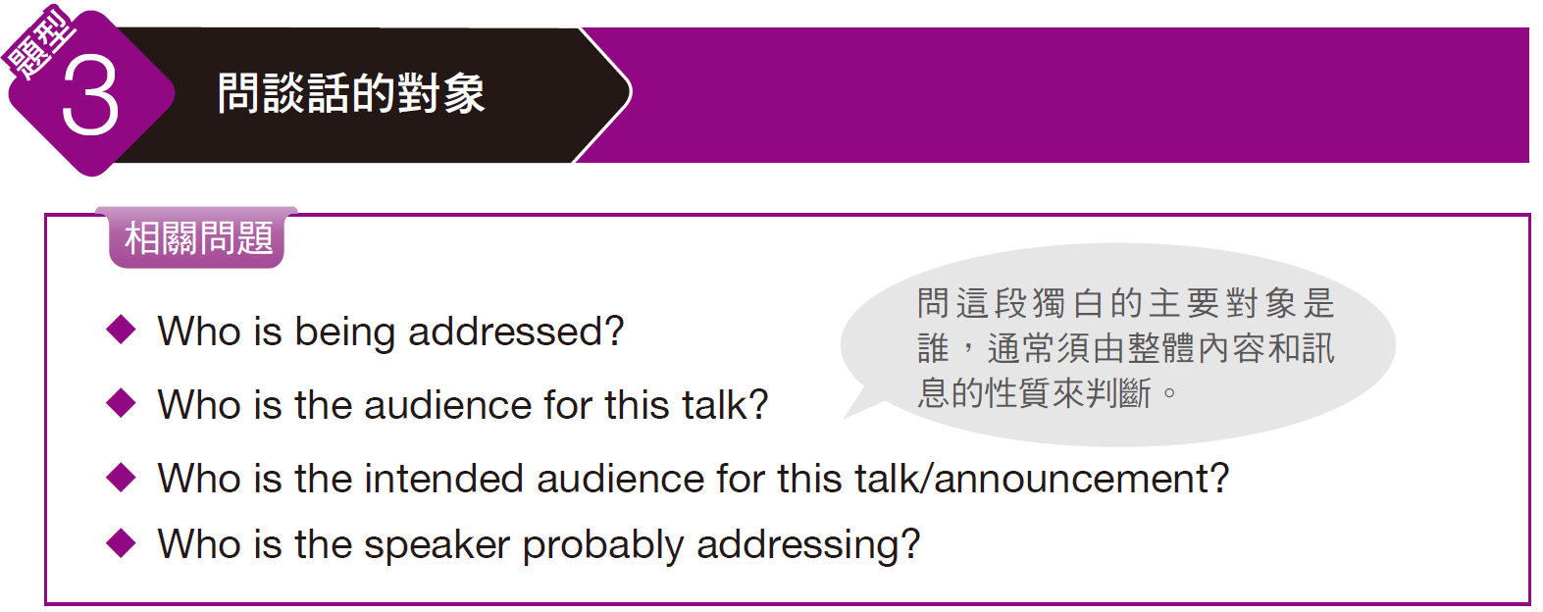
奠基篇 Unit 5

Slide 21
奠基篇 Unit 5
Example
Q: Who is the intended audience for this announcement?
(A) The crew of Beva Airways
(B) All flight attendants
(C) Passengers to Tokyo
(D) Passengers to Hong Kong
錄音內容
The next question refers to the following announcement.
Can I please have your attention? Passengers of Beva Airways Flight BV22 Tokyo to Hong Kong should proceed to boarding gate 19B immediately. Your flight is now in its final stages of boarding. The plane will be leaving the boarding area momentarily. Again, would all passengers on Beva Airways Flight BV22 to Hong Kong please report to gate 19B immediately. This is the final boarding call. Passengers who do not arrive at the gate within the next three minutes will not be permitted to board the aircraft. Thank you.

Slide 22
奠基篇 Unit 5
解析
題目問訊息主要是要傳達給誰。由獨白中的關鍵句 Passengers of Beva Airways Flight BV22 Tokyo to Hong Kong should proceed to boarding gate 19B immediately.「搭乘貝瓦航空編號BV22 航班，由東京飛往香港的旅客，請立即前往 19B 登機門登機。」並重複催促旅客登機，可知答案選 (D)「前往香港的旅客」。
中文翻譯
各位請注意。搭乘貝瓦航空編號BV22航班，由東京飛往香港的旅客，請立即前往19B登機門登機。您的班機現在已經進入最後登機階段。該架班機將在稍後離開登機區。再重複一次，所有搭乘貝瓦航空編號BV22航班飛往香港的旅客，請立即前往19B登機門登機。這是最後一次登機廣播。未能在三分鐘內抵達登機門的乘客，將不會被允許登機。謝謝您。

Slide 23
奠基篇 Unit 5
Exercise
Listen to the audio track. Answer the following question about what the speaker says in the talk.
Q: Who is the speaker probably addressing?
(A) Travel agents
(B) Tourists
(C) Hotel clerks
(D) Construction workers

Slide 24
奠基篇 Unit 5
Audio Transcripts
The next question refers to the following talk.
OK, everyone, now here is one of my favorite sights in Hong Kong. On your right is the world-famous Peninsula Hotel, one of the most recognizable buildings in the city. The hotel was built at the tip of Kowloon Peninsula in 1928. Wealthy travelers who came to Hong Kong by ship or by train stayed here. It is hard to imagine, but the hotel was much closer to the water in the past. All the buildings you see across the street were built quite recently, and there used to be a railroad along the street, with a train station just a few minutes’ walk to the west. In the 1970s and 1980s this area was developed. In 1994, the 30-story building behind the hotel was added to provide extra rooms.
• recognizable (adj.) 可辨識的；辨識度高的 • story (n.)（建築物）層；樓

Slide 25
奠基篇 Unit 5
中文翻譯
好的，各位。這裡是我在香港最喜歡的其中一個景點。您的右手邊是全球知名的半島酒店，也是香港辨識度最高的建築物之一。半島酒店於一九二八年興建於九龍半島的頂端。搭船或火車前來香港的富有旅客都會在此投宿。這很難想像，不過從前半島酒店距離海邊比現在近多了。所有你們在對街看到的建築都是不久之前建造的。以前這條街上有條鐵路，往西邊走幾分鐘就是火車站。這個區域是在一九七○和一九八○年代開發的。一九九四年，酒店後方加蓋了一棟三十層樓的建築，以便提供更多的房間。

Slide 26
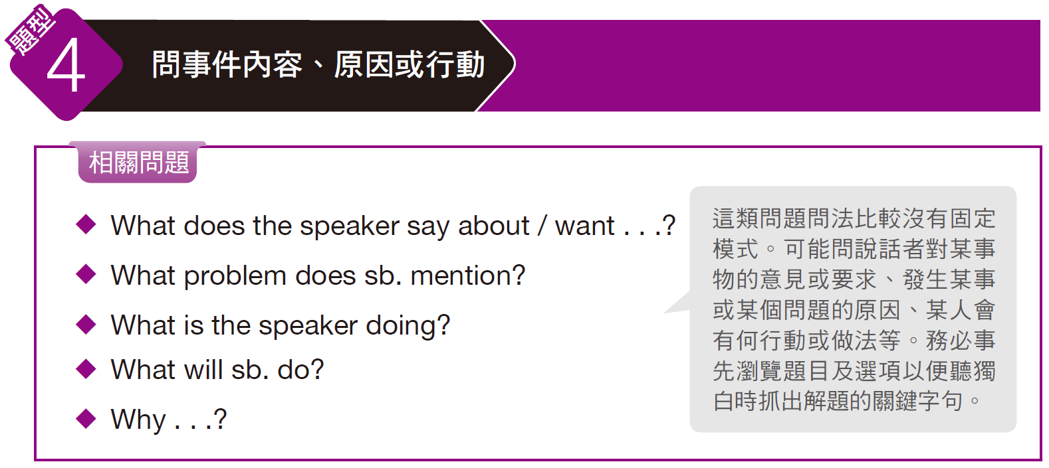
奠基篇 Unit 5

Slide 27
奠基篇 Unit 5
Example
Q: What does the speaker want the city to do?
(A) Build new roads
(B) Repair the roads
(C) Spend money on buses
(D) Keep the price of gas lower
錄音內容
The next question refers to the following radio talk.
Our city needs to invest in its buses. We need to buy new buses and we need to add routes. Currently, most of our buses are more than 20 years old. That makes them loud and uncomfortable to ride, and we spend too much money to maintain them. Moreover, we have too few bus routes on the north side of town. Many people rely on the bus system to get to work and to get to school. And the old buses are a source of pollution. They’re bad for our environment. An investment in our buses is an investment in our environment. Go online to the opinion page on the city website today and tell the city you believe we should improve our bus system.

Slide 28
奠基篇 Unit 5
解析
題目問說話者希望該市做什麼。由獨白中的關鍵句 Our city needs to invest in its buses. We need to buy new buses . . .「我們的城市必須在巴士上做投資。我們必須購買新巴士……」可知答案選 (C)「花經費在巴士上」。
中文翻譯
我們的城市必須在巴士上做投資。我們必須購買新巴士，而且我們必須增加巴士營運路線。目前，我們大多數的巴士車齡都已經超過二十年了，除了發出噪音，坐起來也不舒服，而且我們花太多錢維修這些巴士了。此外，我們城裡的北部地區巴士路線太少了。很多人上班和上學都要靠巴士系統。老爺巴士是污染的來源，這些車對我們的環境有害。投資我們的巴士就等於投資我們的環境。今天就到城市網站的意見頁，告訴這座城市您認為我們應該要改善我們的巴士系統。

Slide 29
奠基篇 Unit 5
Exercise
Listen to the audio track. Answer the following question about what the speaker says in the talk.
Q: Why is Jonathan not at work?
(A) He is meeting with Jenkins Corp.
(B) He had to go to the drugstore.
(C) He is out of town on business.
(D) He has been feeling sick.

Slide 30
奠基篇 Unit 5
Audio Transcripts
The next question refers to the following telephone message.
Hi, Jonathan. This is Betty from work. I’m sorry to hear you haven’t been feeling well all week. It is strange having the desk next to mine empty. When do you think you’ll be back? Anyway, sorry to bother you, but I can’t find our file on Jenkins Corp., and we are meeting with executives from Jenkins Corp. tomorrow morning. And of course, since this is our biggest client, I need to study the file tonight. Any chance you know where it is? Give me a call if you can later. Also, let me know if you need anything. I can always go by the drugstore and pick up medicine for you or anything else you need. Take care, and get better soon. Oh, and call me! Bye.
• bother (v.) 打擾 • drugstore (n.) 藥房

Slide 31
奠基篇 Unit 5
中文翻譯
強納森，你好。我是你的同事貝蒂。我很遺憾聽到你一整個星期以來身體都不適，隔壁桌子空下來的感覺很奇怪。你認為你何時會回來上班呢？無論如何，很抱歉打擾你，但我找不到我們關於Jenkins公司的檔案，而明天早上我們就要和Jenkins公司的管理高層開會了。正因為Jenkins是我們最大的客戶，我今晚必須研究一下那份檔案。你有可能知道檔案在哪裡嗎？可以的話稍後請回我電話。還有，告訴我你需要些什麼，我可以到藥房幫你拿藥，或是看你還需要些什麼東西。保重了，祝早日康復。對了，要打給我喔！再見。

Slide 32
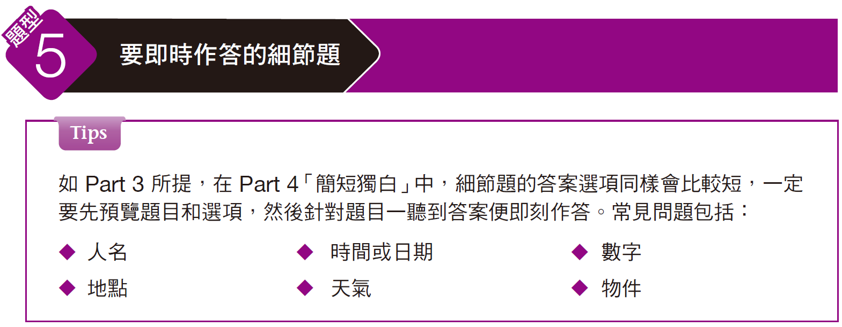
奠基篇 Unit 5

Slide 33
奠基篇 Unit 5
Example
Q: How many hot dogs will people eat this summer?
(A) 150 million
(B) 7 billion
(C) 150,000
(D) 1.9 billion
錄音內容
The next question refers to the following radio broadcast.
Good morning and welcome to “American Food Hour.＂Today we’re going to start by looking at some interesting facts about one of the country’s favorite foods, the hot dog. Did you know it is estimated that this summer Americans will consume some 7 billion hot dogs? That’s a lot of dogs. And they will eat 150 million on the Fourth of July holiday alone. How much money do we spend on hot dogs? Estimates say Americans will spend more than $1.9 billion on hot dogs in supermarkets and grocery stores this year. And where does the popular sausage come from? People in Germany say they invented the hot dog and named it frankfurter, after the German city Frankfurt. People in Austria say they invented it and named it wiener after the Austrian city Vienna.

Slide 34
奠基篇 Unit 5
解析
題目問今年夏天人們會吃掉多少熱狗。關鍵句為 Did you know it is estimated that this summer Americans will consume some 7 billion hot dogs?「您可知道，根據估計，今年夏天美國人將會吃掉七十億條熱狗嗎？」，故選 (B)。選項中亦列出其他獨白中有提到的數字來混淆作答。選項 (A)「一億五千萬」是七月四號美國國慶日所會吃掉的熱狗數量。選項 (D)「十九億」則是美國消費者花在購買熱狗的金額。
中文翻譯
早安，歡迎收看「美國食物時間」節目。今天一開始我們要來看一些關於美國最受歡迎食物的有趣事實。您可知道，根據估計，今年夏天美國人將會吃掉七十億條熱狗嗎？還真多熱狗呢。光是在七月四號那天，美國人就會吃掉一億五千萬條熱狗。我們在熱狗上花多少錢呢？根據估計，美國人今年將會花超過十九億美元在超級市場和雜貨店購買熱狗。而大家喜愛的香腸是來自何方呢？德國人說他們發明了熱狗，並且以法蘭克福這座城市為名，將它取名為法蘭克福香腸。奧地利人說是他們發明了香腸，並且以奧地利的維也納為名，將它取名維也納香腸。

Slide 35
奠基篇 Unit 5
Exercise
Listen to the audio track. Answer the following question about what the speaker says in the talk.
Q: Where is the computer lab?
(A) On the second floor
(B) In the dormitory
(C) Behind the speaker
(D) On the third floor

Slide 36
奠基篇 Unit 5
Audio Transcripts
The next question refers to the following talk.
Welcome to Collins College, where you will spend the next six weeks studying computer animation. I hope all of you have found your dorm rooms. If you had any trouble or have any questions about your dorm room, please see me in a few minutes. Now, all of our computer classrooms are on the second floor of this building. There you will learn how to draw and how to make movies on computers from our leading instructors. Behind me is our state-of-the-art computer lab. Here you will be able to use the newest and most powerful computers. Most of you of course have brought your own laptops, but you’ll quickly find that the software we’re using needs more powerful computers. Now, let’s hear from our department head, Lenny Talbot.
• instructor (n.) 教員；大學講師
• state-of-the-art (adj.)（科技等產品）最先進的；最高級的
• lab (n.) 實驗室（= laboratory） • laptop (n.) 筆記型電腦

Slide 37
奠基篇 Unit 5
中文翻譯
歡迎來到科林斯學院，未來六個星期各位將在此學習電腦動畫。我希望各位都已經找到您的宿舍房間了。如果您對於您的宿舍房間有任何困難或問題，請在幾分鐘之後來找我。我們所有的電腦教室都位在本棟大樓的二樓，各位將在電腦教室中，從我們的首席講師那兒學習到如何利用電腦來繪圖以及製作電影。在我身後是一座最先進的電腦實驗室。各位將可以在這裡使用到最新且運算能力最強的電腦。各位大部分都已帶了自己的筆記型電腦來，但是各位很快將會發現我們使用的軟體，需要使用到運算能力更強的電腦。我們現在就請系主任藍尼‧塔伯特來跟我們說幾句話。

Slide 38
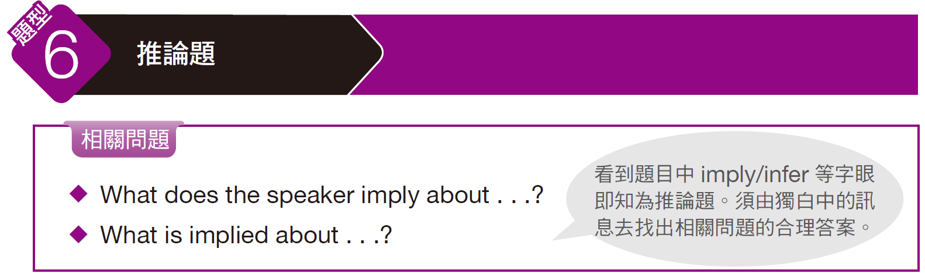
奠基篇 Unit 5

Slide 39
奠基篇 Unit 5
Example
Q: What is implied about the cell phones in the future?
(A) They’ll be as popular as the iPad.
(B) They’ll be replaced by tablet computers.
(C) They’ll have as many functions as laptops.
(D) Major tech companies will give them new names.
錄音內容
The next question refers to the following speech.
What will be the smartphone of the future? There is a good question. Now, 30 years ago, no one had cell phones. A communications device you could carry around with you was something you could see only in science fiction movies. But today everyone has one, and today you can write e-mail on them and even watch TV. So what will our telephones be like 20 years from now? For one, they will be a lot like your desktop computer. You’ll be able to do anything on your phone that you can do on your computer. Soon, your phone will look a lot like a tablet computer, like the popular iPad. That is why the big names in computers are investing heavily in technology for mobile phones—companies like Intel, Apple, Microsoft and others.

Slide 40
奠基篇 Unit 5
解析
題目問未來手機可能會演變成怎樣。由關鍵句 You’ll be able to do anything on your phone that you can do on your computer. Soon, your phone will look a lot like a tablet computer . . .「你可以在電話上做任何你會在電腦上做的事。很快的，你的電話看起來會很像一台平板電腦……」可知應選 (C)「它們會有像筆電一樣多的功能。」
中文翻譯
未來的智慧型手機會是什麼樣子呢？這是個好問題。三十年前，沒有人有行動電話。你只會在科幻電影裡看到可以讓人帶著走的通訊工具。但是時至今日，人人都有手機，你可以用手機寫電子郵件，甚至看電視。所以二十年後，我們的電話會是什麼樣子呢？其中一種可能，電話會長得跟桌上型電腦很像，你可以在電話上做任何你會在電腦上做的事。很快的，你的電話看起來會很像一台平板電腦，就像現在風行的iPad一樣。這也就是為何英特爾、蘋果、微軟和其他大型電腦公司會在行動電話技術方面砸下重金的原因。

Slide 41
奠基篇 Unit 5
Exercise
Listen to the audio track. Answer the following question about what the speaker says in the talk.
Q: What does the speaker imply about Tech-No-Fear?
(A) The investors have low expectations of the company.
(B) The stock price is way too low.
(C) The company desperately needs more funds.
(D) The investors are positive about the company.

Slide 42
奠基篇 Unit 5
Audio Transcripts
The next question refers to the following news show.
In business news today, it appears that there is a new kid on the technology block. A company called Tech-No-Fear went public on the New York Stock Exchange this morning, and the highly hyped group was well-received by investors. Tech-No-Fear is a start-up by newcomer Henrietta Thomas. Ms. Thomas had her start in the watch business, but that was short lived. In interviews she has said Tech-No-Fear’s quick appearance was due to angel investors, who altogether granted her over $20 million in less than two months. Tech-No-Fear designs “smart” skateboards and other extreme sports equipment. They’re “smart” because they’re outfitted with technological advances. Their products have been well-reviewed in the market. It appears others are taking note of Ms. Thomas. The opening share price of $3 moved quickly to $10 before leveling off at $9 by noon. The stock closed at that same price. It will be interesting to see if Tech-No-Fear lives up to investors’ high expectations.
• hype (v.) 廣為宣傳
• angel investor 獨立投資人（直譯為「天使投資者」，俗稱「金主」，指財力豐厚的個人，對具潛力的初創企業進行投資」）
• grant (v.)給予；授予 • outfit (v.)裝備；配備 • level off 達到平衡；將⋯⋯弄平

Slide 43
奠基篇 Unit 5
中文翻譯
在今天的商業新聞方面，看來科技產業又出現後起之秀了。一家名叫「無畏科技」的公司今天上午在紐約證券交易所公開上市，這家被高度炒作的集團受到投資人的青睞。無畏科技是一家由科技業新手亨莉塔‧湯瑪斯成立的新公司。湯瑪斯女士是以鐘錶業起家，但該項事業並未維持太久。湯瑪斯女士在接受訪問時表示，無畏科技之所以能快速成立乃拜一群獨立投資人之賜，這些人在不到兩個月的時間內給了她總計兩千多萬美元的資金。無畏科技設計「智慧型」滑板和其他極限運動器材。稱之為「智慧型」是因為這些器材都配備了先進科技。該公司的產品在市場上頗受好評。似乎別人也注意到了湯瑪斯女士。無畏科技的股價從一開盤時的三美元，迅速竄升至十美元，一直到中午時守穩在九美元，並以每股九美元收盤。無畏科技能否滿足投資人的高度期待值得注意。

Slide 44
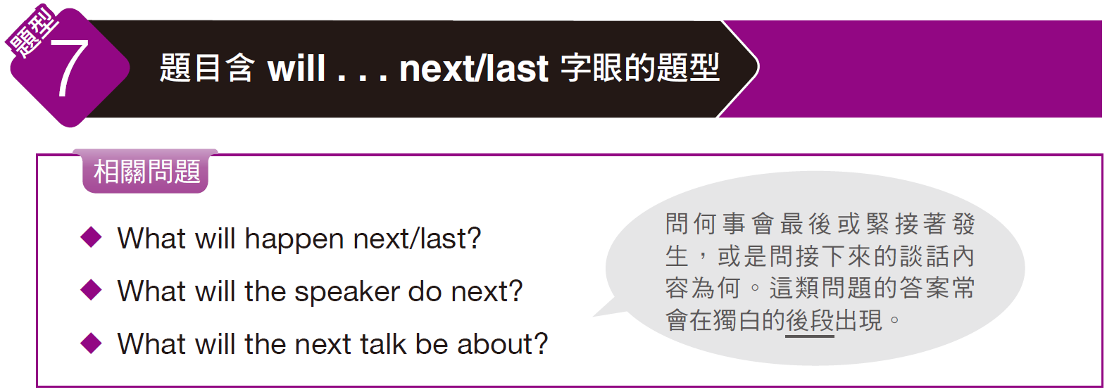
奠基篇 Unit 5

Slide 45
奠基篇 Unit 5
Example
Q: What will happen next?
(A) A Q&A session will be given.
(B) Some slides will be shown.
(C) A baseball game will begin.
(D) The uniforms will be given out.
錄音內容
The next question refers to the following talk.
Thanks, everyone, for coming. Today I want us to look at sponsoring a sports team as part of our fall advertising. Many companies today, from banks to software companies, are giving corporate sponsorships to sports teams. And this would be ideal for a grocery store chain like ours. Now, as you know, our city has a new minor league baseball team, the Cliffside Eagles. We can work out a deal where we promote the team and their games in all of our stores. In return, the team will show our name and logo around the stadium, on their website, and even possibly on their uniforms. Now, I’m going to start a slide-show presentation that will give you all further details . . .

Slide 46
奠基篇 Unit 5
解析
題目問接下來會發生何事。關鍵在最後一句 Now, I’m going to start a slide-show presentation . . .「現在我要開始進行投影片的簡報……」可知答案選 (B)「將會放映一些投影片。」選項 (A)的 Q&A session 指「問答時間」；(D) 的片語 give out 指「分發」。
中文翻譯
謝謝各位前來參加。今天我要講的是以贊助一支運動團隊，做為我們公司秋季廣告的一部分。現在有很多公司，從銀行到軟體公司，都會對運動團隊提供企業贊助。這麼做相當適合我們這一類的雜貨店連鎖企業。誠如各位所知，本市成立了一支新的小聯盟棒球隊，隊名為「崖邊之鷹」。我們可以擬定一套方案，由我們在我們所有店鋪中為該隊伍及其比賽做宣傳。作為回報，該支隊伍則會在體育館的周邊、在他們的網站上、甚至有可能在他們的制服上放上我們公司的名稱和商標。現在我要開始進行投影片的簡報，為各位進一步講解細節內容……

Slide 47
奠基篇 Unit 5
Exercise
Listen to the audio track. Answer the following question about what the speaker says in the talk.
Q: What does the speaker say will happen next?
(A) He will show a movie about energy.
(B) Researchers will answer questions.
(C) Volunteers will come to the tables.
(D) The speaker will give out handouts.

Slide 48
奠基篇 Unit 5
Audio Transcripts
The next question refers to the following talk.
Ladies and gentlemen: Thank you for coming to tonight’s fund-raising banquet. I’d like to draw your attention to the screen behind me. We’re going to be showing a brief video clip that will introduce the ever-increasing need for sustainable energy in the manufacturing industry. As you all very well know, today’s global economy relies on non-sustainable energy resources, such as fossil fuels. How to introduce energies such as solar and hydroelectric power to our factories and plants still isn’t fully understood by industry professionals. But this isn’t the fault of production managers. Researchers need to be out in full force. We need to be telling the world about developments in sustainable energy. But, the research and marketing of our discoveries need funding. You might have noticed that each table has an empty seat. Following the presentation, that seat will be occupied by one of our researchers. He or she will walk you through our current research projects and answer your questions about sustainable energy. Now, for the show.
• sustainable energy 永續能源 • hydroelectric (adj.) 水力發電的

Slide 49
奠基篇 Unit 5
中文翻譯
各位先生，女士們：感謝您前來參加今晚的募款餐會。我要請各位注意我身後的螢幕。我們將要放映一段短片，介紹製造業對於永續能源日益升高的需求。誠如各位所熟知的，當前的全球經濟仰賴的是非永續能源，例如化石燃料。產業界的專家至今仍未能全然明白如何讓工廠採用諸如太陽能和水力發電，但這並不能責怪生產經理。研究人員必須全面出動。我們必須告訴全世界有關永續能源的發展情形。但這項針對我們的發現所進行的研究和行銷都需要資金。您可能已經注意到每張桌子都有一張椅子是空的。在簡報之後，我們的研究人員將會坐上那些椅子。他們將為各位仔細講解我們目前的研究計畫，並回答您關於永續能源的問題。現在就開始進行我們的節目。

Slide 50
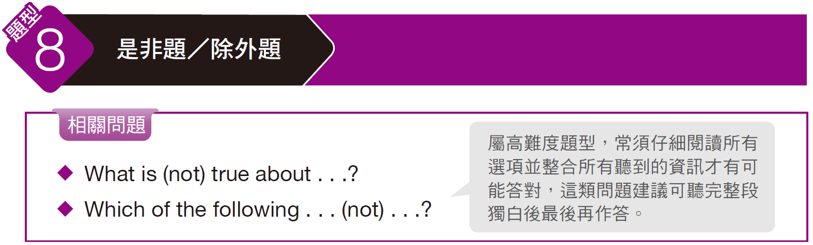
奠基篇 Unit 5

Slide 51
奠基篇 Unit 5
Example
Q: According to the speaker, which of the following statements is true?
(A) Helen will send Donald the agenda for the staff meeting.
(B) Helen thinks their customer service is great.
(C) The store had more registers than cashiers today.
(D) If they hire new workers, it could harm their business.
錄音內容
The next question refers to the following telephone message.
Hi, Donald, this is Helen. Can we arrange a meeting sometime this week? I need to discuss staffing in our store with you. We need more people in the store and more people working the registers. Ever since we began our new promotions, the store has been flooded with customers. And our motto, and the motto that has made our store successful over the years, is “Customer service is No. 1.＂ But without enough employees, our customer service suffers. Today we had long lines at each cash register, but only enough cashiers for half of them. Can we meet sometime tomorrow? I believe honestly that if we increase our staffing levels, our business will improve even more.

Slide 52
奠基篇 Unit 5
解析
題目問哪項敘述正確。選項 (A)「海倫會把員工會議的議程寄給唐諾。」不對，留言中是說她想開會討論人力配置（staffing）的問題。選項 (B)「海倫認為他們的客服很棒。」也不對，留言中指出因人手不足客服連帶受損（our customer service suffers）。選項 (C)「今日店裡的收銀機比結帳員多」為真，關鍵句為Today we had long lines at each cash register, but only enough cashiers for half of them.。選項 (D)「若他們雇用新員工，將有損事業。」為非，整段主旨在說明需要更多人手的原因及必要性。
中文翻譯
嗨，唐諾，我是海倫。我們本週能否找個時間開會？我得和你討論我們店裡找人手的問題。我們店裡需要更多人手，還要更多人手幫忙收銀。自從我們展開新的促銷活動後，店裡就擠滿了顧客。我們的座右銘，也就是讓我們的店這些年來如此成功的座右銘是：「客戶服務第一」，但在缺乏足夠員工的情況下，我們的客戶服務便連帶受損。今天我們每台收銀機前都大排長龍，但我們的結帳員只夠應付一半的收銀機台。我們明天能否找個時間碰面？我真的認為如果我們增加員工數目，我們的生意將會更上一層樓。

Slide 53
奠基篇 Unit 5
Exercise
Listen to the audio track. Answer the following question about what the speaker says in the talk.
Q: According to the speaker, which of the following is true?
(A) People used their PDAs with their PCs.
(B) PDAs were more powerful than smartphones.
(C) PDAs were less powerful than smartphones.
(D) PDAs were more expensive than smartphones.

Slide 54
奠基篇 Unit 5
Audio Transcripts
The next question refers to the following radio show.
Fifteen years ago, the personal digital assistant, or PDA, was a popular device. PDAs allowed people to carry with them their calendars, address books, to-do lists, and more. The problem was, most PDAs did not link to people’s personal computers, so many people stopped using them. Today, though, we have smartphones that do all the things PDAs did and a whole lot more. And they not only link to our computers; they are mini computers themselves. And before long, we may stop using our personal computers because our smartphones are more powerful.

Slide 55
奠基篇 Unit 5
中文翻譯
十五年前，個人數位助理，或稱為 PDA，是項很受歡迎的工具。PDA 能讓人隨身帶著個人的行事曆、通訊錄、工作清單和其他東西。問題是，大部分的 PDA 並未和人們的個人電腦連結，所以很多人就不再使用 PDA 了。而如今，智慧型手機能幫我們做所有 PDA 能做到的事，而且功能還更多。智慧型手機不只能連結我們的電腦，它們本身就是個迷你電腦。不久之後，我們可能就不會再使用個人電腦，因為我們的智慧型手機的功能更強大了。

Slide 56
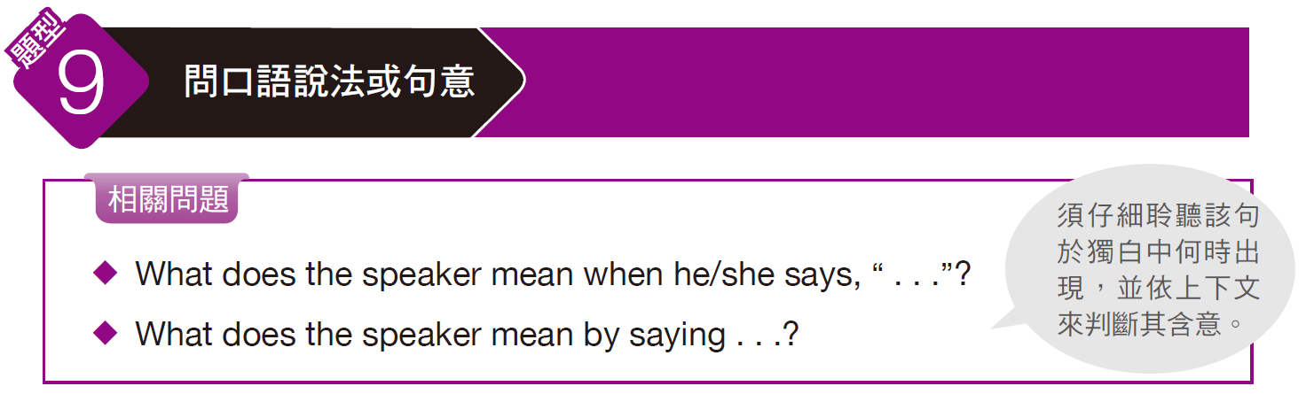
奠基篇 Unit 5

Slide 57
奠基篇 Unit 5
Example
Q: What does the speaker mean when he says, “we’ll make it”?
(A) They will cook good food.
(B) They will make enough money.
(C) Their jobs will be easy.
(D) They will be successful.
錄音內容
The next question refers to the following pep talk.
Listen, folks. We’re going to be packed tonight. Dinner service starts in . . . just over an hour, and we’ve got a few big parties on top of the usual weekend crowd. There’s a party of ten at 7:00 and twelve at 7:30. I know we’ll make it, but we’re going to have to work together and get everything ready ahead of time. Clean your tables, never leave the kitchen empty-handed, and, well, communicate! Always ask your fellow servers if they need help. Thanks for your hard work and let’s serve great food and a nice experience.

Slide 58
奠基篇 Unit 5
解析
題目問we’ll make it在獨白中的含意。說話者在前一句說到他們於七點及七點半會各有十人及十二人的訂位，接著又說必須合作並事先做好準備，故知他是指雖然當晚客人很多（關鍵字詞為一開頭的packed、big parties、weekend crowd），只要分工合作並預備周全就能順利完成工作，答案選(D)。
中文翻譯
大家聽好。今晚客人會非常多。晚餐服務再過……一個多小時就要開始了，平常我們的週末便是人潮顛峰時刻，現在又加上有幾組團體訂位。七點及七點半會各有十人及十二人的訂位。我知道我們可以順利完成工作，但我們必須分工合作並預備周全。把桌子清乾淨，不要空手離開廚房，以及，嗯，要溝通！要經常去問你的服務生同事是否需要幫忙。感謝你們的辛苦工作，讓我們提供客人超棒的料理以及愉快的用餐體驗吧。

Slide 59
奠基篇 Unit 5
Exercise
Listen to the audio track. Answer the following question about what the speaker says in the talk.
Q: What does the man mean when he says, “There’s no easy way to put this”?
(A) He isn’t sure how to express his opinion.
(B) What he is about to say cannot be expressed in a positive manner.
(C) He doesn’t know which words to use to convey his thoughts.
(D) There is no better time to state his thoughts.

Slide 60
奠基篇 Unit 5
Audio Transcripts
The next question refers to the following talk.
Good morning and thank you to everyone for being on time today; we have much to discuss. //There’s no easy way to put this//, so I’m just going to say it. I think that Veracity Talent Management is the wrong choice for Erica Barker. While they have shown a great deal of interest and care for her career, I think that Veracity is more concerned about her instant success as opposed to the long-term picture. Erica is a very young artist and has to think not just about this upcoming year, but several years to come. It is because of this that we have decided to move forward with Creed Associates for talent representation. Thank you so much for your time, and I will now make myself available to answer any questions.
• veracity (n.) 誠實 • a great deal of 大量的 • be concerned about 關心
• as opposed to 而非；相較於 • representation (n.) 代理

Slide 61
奠基篇 Unit 5
中文翻譯
早安，謝謝各位今天準時到場；我們有很多事情要討論。要談這件事情並不容易，所以我就直說了。我覺得對艾麗卡‧巴克來說，選擇誠實人才管理公司是個錯誤。雖然他們對其職業生涯展現出濃厚的興趣和關心，但我覺得該公司更關心其立即的成功，而不是長期的遠景。艾麗卡是位非常年輕的藝術家，她必須不只是想著來年，而是要考慮未來幾年的情況。正因如此，我們已決定改由信念集團擔任藝人代理。非常感謝各位的寶貴時間，我現在可以回答任何問題。

Slide 62
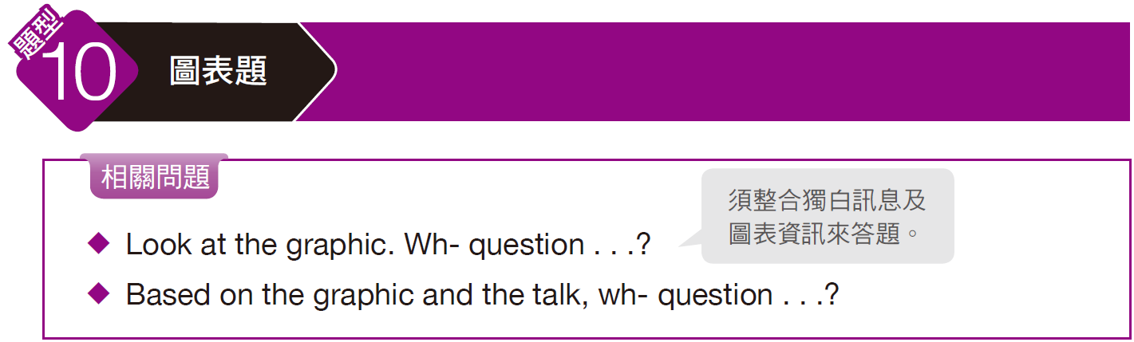
奠基篇 Unit 5

Slide 63
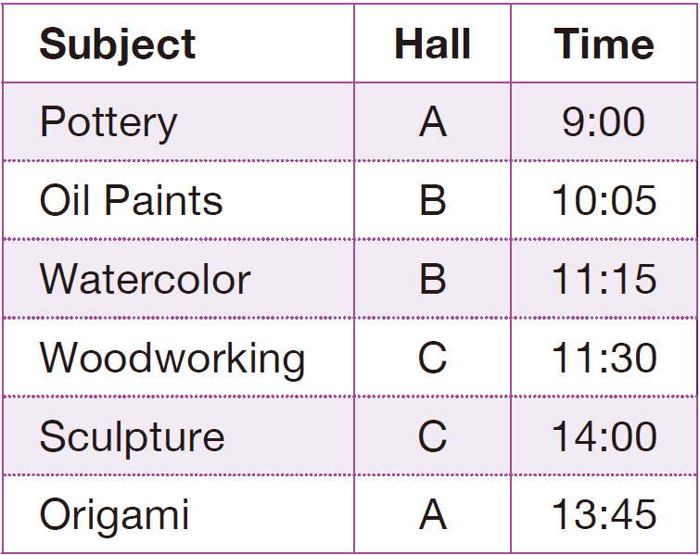
奠基篇 Unit 5
Example
Q: Look at the graphic. Which two workshops could not be taken on the same day?
(A) Pottery and oil paints
(B) Oil paints and watercolor
(C) Watercolor and woodworking
(D) Oil paints and woodworking
錄音內容
The next question refers to the following speech and timetable.
Welcome to our third annual arts festival. This is just the first of three days, and there are even more options tomorrow and Sunday. Please be aware that due to staff schedules, the workshops held in hall B are only being held today. All others will be repeated throughout the weekend. All sessions are one hour long, except for pottery, which is 75 minutes, and woodworking has been moved back an hour, to 12:30. I’ll be at the information desk if you have any questions . . . Oh! And be sure to fill out your workbooks for next week’s follow-up discussions. Have a great time!

Slide 64
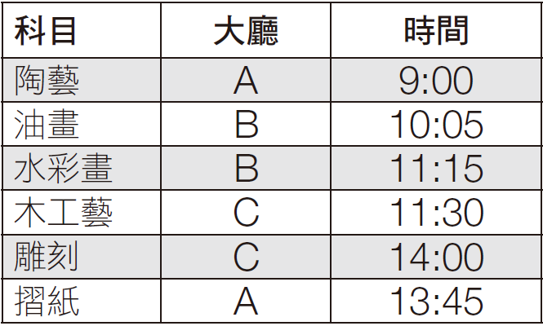
奠基篇 Unit 5
解析
題目問「看圖表，哪兩個課程無法在同一天進行？」。關鍵在獨白中說到除pottery「陶藝課」是七十五分鐘外，其餘課程都是一個小時。因此選項(A) 的兩個課程（陶藝與油畫）時間會重疊到，故為答案。另外，由於獨白中說到woodworking「木工藝課」往後延一小時，故選項(C) 的兩個課程（水彩畫與木工藝）時間就不會重疊到了。
中文翻譯
歡迎來到我們第三屆的年度藝術節。今天只是三天節慶當中的第一天，明天和星期天會有更多的課程選擇。請瞭解由於工作人員日程安排的原因， 在B 大廳舉行的手作課程只會在今天舉行。其他所有手作課程則將於整個週末重複舉行。所有課程為時一小時，除了陶藝課是七十五分鐘，而木工藝課的時間已被調到十二點半，比原先要晚一個小時。您若有任何問題， 我會在服務台恭候大駕……噢！還有請務必要填寫您的工作筆記本，為下星期的後續討論做準備。祝您玩得開心！

Slide 65
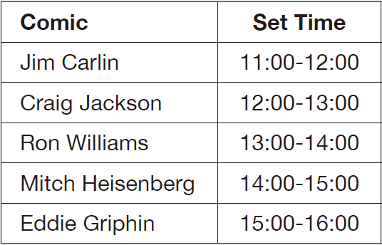
奠基篇 Unit 5
Exercise
Listen to the audio track. Answer the following question about what the speaker says in the talk.
Q1: Based on the graphic and the talk, who will be the last comic performing?
(A) Jim Carlin
(B) Mitch Heisenberg
(C) Craig Jackson
(D) Eddie Griphin

Slide 66
奠基篇 Unit 5
Audio Transcripts
The next question refers to the following introduction and timetable.
Hello and good evening! I’m so happy that everyone could make it here tonight. The night is sure to be full of laughs and good fun, but one important thing before we get started: please be sure to refrain from talking during each comic’s performance. It is fine to take pictures, and there are drinks available in the back at the bar. Also, the program under your seats will provide a list of the comics performing and their set times. The only change that needs to be made is Craig Jackson’s set time. His plane has been delayed in Chicago, and he will not make it until the final set time. Thanks so much and enjoy the show!
• make it 及時趕到 • refrain from 避免 • program (n.) 節目單 • delay (v.) 耽擱

Slide 67
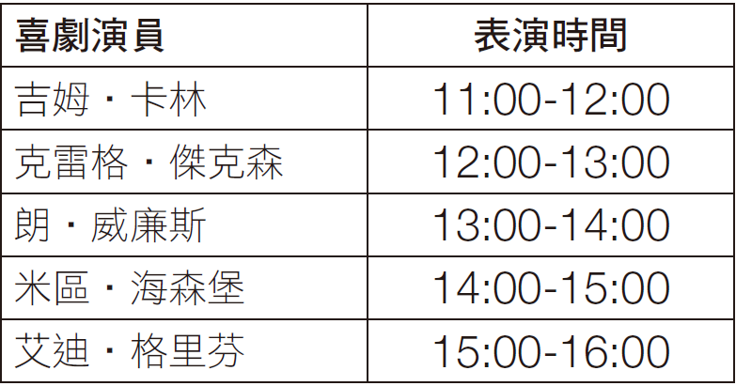
奠基篇 Unit 5
中文翻譯
哈囉晚安！我真開心大家今晚能趕來。今晚一定會充滿歡笑和樂趣，但在我們開始之前，有件重要的事情要宣布：在每場喜劇表演期間請勿交談。可以拍照，後面的吧台有飲料。還有，您椅子下面的節目單會提供喜劇表演的清單和表演時間。其中唯一需要修正的是克雷格‧傑克森的表演時間。他的班機在芝加哥誤點了，他直到最後的表演時段才能趕到。真的非常感謝各位，好好享受今晚的表演！

Slide 68
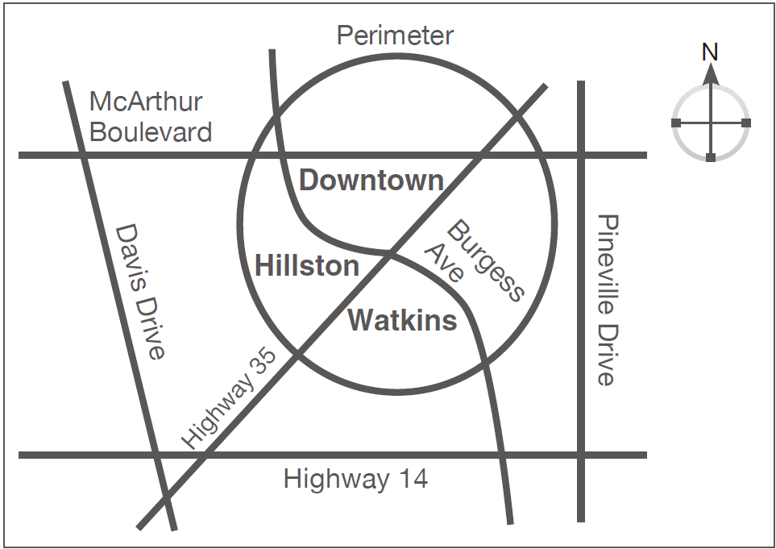
奠基篇 Unit 5
Q2: Look at the graphic. What is the best way to get into downtown from the south?
(A) Highway 35 to McArthur Boulevard
(B) Davis Drive to McArthur Boulevard
(C) Highway 14 to Burgess Ave
(D) Highway 35 to the Perimeter

Slide 69
奠基篇 Unit 5
Audio Transcripts
The next question refers to the following traffic report and map.
Rise and shine, Livingston residents! It’s a wet one out there, so you might want to get out the door a little earlier than usual! Let’s have a look at the city map. The most severe congestion is heading northbound on Highway 35 toward downtown. Take another route if you are headed that way. It’s bumper-to-bumper in both directions on Burgess because of construction. Southbound into downtown on 35 is smooth sailing through to McArthur Boulevard, but look out for school traffic on both sides of Pineville Drive. Remember, the Perimeter may be a longer route, but it’s currently pretty clear, so it might be worth taking the long way.
• congestion (n.) 擁堵 • northbound (adj.) 北行的
• bumper-to-bumper (adj.)一輛緊接一輛的 • southbound (adj.) 南行的
• smooth sailing 一帆風順

Slide 70
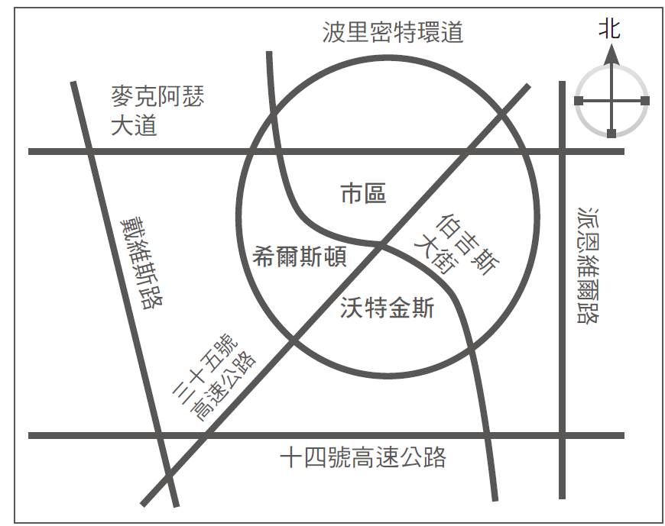
奠基篇 Unit 5
中文翻譯
李文斯頓的居民們，快起床！今天是下雨天，所以我建議你最好比平常更早出門！我們來看一下城市地圖。三十五號高速公路北上往市區方向塞車最嚴重。如果你要往那個方向，可以改走別條路線。伯吉斯大街上因為有工程，雙向交通都非常擁堵，車子一輛緊接一輛時速緩慢。三十五號高速公路往南進入市區的交通一直到麥克阿瑟大道都保持暢通，但要注意派恩維爾路雙向有上學的車潮。記住，走波里密特環道比較遠，但它目前車流量很少，所以繞遠路應該是值得的。

Slide 71
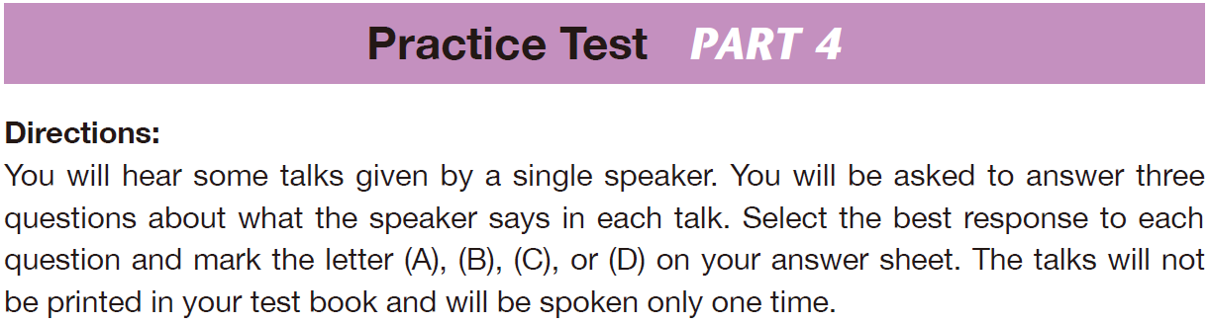
奠基篇 Unit 5

Slide 72
奠基篇 Unit 5
C
D
C
1. Who is the audience for this talk?
(A) Professors
(B) Restaurant hosts
(C) Club members
(D) Club organizers
2. What will attendees get to talk about at the meetings?
(A) How to make coffee
(B) How to organize a club
(C) How to give speeches
(D) What their businesses do
3. What will happen next?
(A) The attendees will listen to speeches.
(B) Helen Thomas will give speeches.
(C) The attendees will learn about each other.
(D) The attendees will discuss the club’s business.

Slide 73
奠基篇 Unit 5
Audio Transcripts
Questions 1-3 refer to the following talk.
Welcome to the first meeting of our new City Business Club. My name is Helen Thomas, and I’m one of the club’s organizers. I am glad to see so many people attend. Our club will meet at this time every Wednesday morning for coffee, tea and snacks. We will also have brief programs that will include speeches, business introductions, and discussion of what we should do more of as a club. Each member of the club will from time to time have a chance to get up and talk about his or her profession or business. These talks are only one of many ways each of you will have to promote your businesses. Now let’s get started this morning by getting to know one another. Each of you has a name tag on your shirt. Please take ten minutes to get to know everyone at your table.

Slide 74
奠基篇 Unit 5
中文翻譯
歡迎來到我們的新城市商務俱樂部的首場會議。我叫海倫．湯瑪斯，我是俱樂部的主辦者之一，很高興看到有這麼多人與會。我們的俱樂部在每週三早上這個時間聚會喝咖啡、茶和用點心。我們還會準備簡短的節目，包括演講、行業介紹以及討論我們俱樂部還應進行哪些其他活動。每位俱樂部會員不時會有機會到台上來說說自己的職業或所從事的生意。這些演說將只是各位用來推廣業務的眾多方式之一。我們就先從認識彼此來開始今天早上的活動。各位的衣服上都別了名牌，請花十分鐘時間認識和您同桌的人。

Slide 75
奠基篇 Unit 5
A
C
B
4. What does the speaker thank Becky and Jason for?
(A) Organizing the retreat
(B) Selling the most products
(C) Helping with the charity project
(D) Delivering the products on time
5. What does the speaker mean by saying “give a shout-out”?
(A) The speaker will say this part louder.
(B) The speaker wanted everyone to cheer and applaud.
(C) The speaker wanted to give recognition to someone.
(D) The speaker wanted everyone to quiet down.
6. What did the speaker state about Knit Pickers?
(A) They are going on a company retreat with them.
(B) They will be working with them on charity projects.
(C) They are merging with their company.
(D) They will be selling to them.

Slide 76
奠基篇 Unit 5
Audio Transcripts
Questions 4-6 refer to the following speech.
Good evening, and welcome to the thirty-fifth annual Yarn and String Incorporated company retreat. To start, I would like to give a big “thank-you” to Becky and Jason for putting together this trip for us. You two did great . . . I would also like to //give a shout-out// to our sales and distribution department. Along with a rise in sales, they also had an on-time delivery rate of 97 percent. Of course, our success this year would not have been possible without everyone’s hard work and determination, and for that I want to thank you all. Oh, and one last thing . . . I am happy to announce that next quarter we will be teaming up with the good folks at Knit Pickers, the knitting supply store, to collaborate on a few charity projects within our community.
• company retreat（結合相關訓練、課程或休閒活動的）公司退修會；員工旅遊
• distribution (n.) 配銷；分配 • determination (n.) 決心
• team up with 與⋯⋯合作 • collaborate on 合作從事

Slide 77
奠基篇 Unit 5
中文翻譯
謝謝各位前來參加我們今晚的活動。為了幫我們的大學募款，我們正舉辦一場無聲藝術拍賣會。各位看到的所有美麗畫作都在拍賣之列。拍賣規則如下。各位先到票亭買票，每張票二十美元。你愛買幾張就買幾張。接下來，在每張票上寫下您的大名和電話號碼，然後去找出您希望贏到的畫作那兒，將您的票丟進畫作前方的罐子裡。每個罐子您最多可以投入十張票，不得超過十張，然後選擇越多張你想要的畫越好。晚會的最後，我們會從每張畫的罐子裡抽出一張票，如果票上寫了您的名字，您就可以將畫帶回家。

Slide 78
奠基篇 Unit 5
C
B
B
7. What does the speaker need help with?
(A) Choosing a travel destination
(B) Solving a problem at the Hong Kong office
(C) Buying an airline ticket
(D) Arranging a meeting
8. How many nights will the speaker be in Hong Kong?
(A) One
(B) Two
(C) Three
(D) Four
9. What does the speaker want Dan to tell the manager
in Hong Kong?
(A) That there is a problem
(B) That she will be visiting
(C) That she is stuck in meetings
(D) That she can’t go to Hong Kong

Slide 79
奠基篇 Unit 5
Audio Transcripts
Questions 7-9 refer to the following voice-mail message.
Hi, Dan, this is Nancy calling. Listen, I need you to do me a favor. I need to make urgent travel arrangements for a trip to Hong Kong, and I’m downtown stuck in meetings all afternoon. Can you make arrangements for me? I need a round-trip plane ticket to Hong Kong. I want to depart on Wednesday and return on Friday, and I’d like to fly business class. I’ll also need a hotel room for two nights near our Hong Kong office. Can you help me contact the manager of our Hong Kong office and let him know I’m coming? I’m really sorry to bother you, Dan, but this is urgent. You can text me if you have any questions. Thanks.
• stick (v.)【口】以……困住（stuck 為 stick 的過去式和過去分詞）
• depart (v.) 啟程；離開 • text (v.) 傳簡訊

Slide 80
奠基篇 Unit 5
中文翻譯
嗨，丹，是我南希。我需要你幫我一個忙。我需要緊急安排一趟到香港的旅程，我一整個下午人都在市中心開會，你能不能替我安排？我需要買一張香港的來回機票。我要星期三出發，星期五回來，我想搭商務艙。我還需要在一間靠近我們香港辦公室的飯店住兩晚。你能幫我聯絡我們香港辦公室的經理，告訴他我要過來嗎？丹，真的很抱歉打擾你，但是這件事很緊急。如果有任何問題，你可以傳簡訊給我。謝謝。

Slide 81
奠基篇 Unit 5
D
C
D
10. Who is the speaker probably addressing?
(A) CEOs
(B) Internet site designers
(C) Software designers
(D) New stock investors
11. What does the speaker say he likes to know before buying a stock?
(A) How much data the company puts on the Internet
(B) Research on companies’ history
(C) How much money the company heads make
(D) Estimates on how much a stock will rise
12. Which is true about the information the speaker is discussing?
(A) It is complex to use.
(B) It is expensive to use.
(C) All companies use it.
(D) It does not cost money.

Slide 82
奠基篇 Unit 5
Audio Transcripts
Questions 10-12 refer to the following talk.
Good morning. Today we’re going to talk about how to use the Internet to research the stock market. The Web has completely changed the way we learn about and watch stocks, offering real-time data and research tools. Using free tools and websites, you can get all kinds of information on public companies. You can learn how much money they are making—or losing—and what they are spending that money on. Now, if I invest in a stock, the questions I want to ask are, how much money the company’s CEO and other top managers are making, what their salaries are, and how much they are making in stocks and bonuses. Well, it’s all out there on the Internet and for free. And tonight I’m going to show you just a little of what you can do.
• stock market 股市 • real-time (adj.) 即時的

Slide 83
奠基篇 Unit 5
中文翻譯
早安，今天我們要來談如何使用網際網路進行股票研究。網路已完全改變了我們學習和觀看股票的方式，網路提供了即時的數據和研究工具。藉由使用免費的工具和網站，你可以取得關於公開發行公司的所有資訊。你可以知道這些公司賺了多少錢，或賠了多少錢，以及他們把錢花到了哪裡。現在，如果我投資一檔股票，我要問的問題是，這家公司的執行長和其他高層經理賺多少錢，他們的薪水是多少，以及他們賺了多少股票和紅利。這些資料都免費公布在網路上。今晚我要來教各位一些操作小技巧。

Slide 84
奠基篇 Unit 5
B
A
B
13. What is the message mainly about?
(A) The speaker is planning to open a company.
(B) The speaker wants some advice for a friend.
(C) The speaker needs to rent an office.
(D) The speaker is planning a dinner party.
14. Which of the following is something the man
opening an office needs help with?
(A) Renting furniture
(B) Moving furniture
(C) Buying airline tickets
(D) Finding a restaurant
15. What does the speaker mean when she says, “I’m hoping to get him some contacts”?
(A) She wants to buy something to improve her friend’s vision.
(B) She wants to help her friend make networking relationships.
(C) She wants to help her friend meet people to hang out with.
(D) She wants to build a mailing list for her friend.

Slide 85
奠基篇 Unit 5
Audio Transcripts
Questions 13-15 refer to the following voice-mail message.
Hi, Mike, this is Judy. I’m calling to find out if you could join me for lunch one day next week. I am hoping to get some advice from you. I have a friend who’s planning to open a business here in town early next year. But he doesn’t know anyone here, so I’m hoping to get him some contacts. He’s going to need to find a real estate agent, so he can rent an office. He’s also going to need to buy or rent furniture and office equipment, and probably find a good accountant, not to mention find other professional services. Oh, I almost forgot—he’s also going to need to find a place to live. Please let me know if you’re free one day next week, and I’ll buy you lunch. Give me a call. Thanks. See you.
• real estate agent 房地產經紀／仲介 • accountant (n.) 會計師

Slide 86
奠基篇 Unit 5
中文翻譯
麥克，我是茱蒂，我打來是想知道下星期你能否找一天和我吃頓中飯？我希望聽聽你的意見。我有個朋友正在計畫明年初在這個鎮上開一家公司，但是他在這裡沒有熟人，所以我希望幫他找幾個可以聯絡的對象。他需要找個房地產仲介，讓他能租間辦公室。他還需要買或租家具和辦公室設備，或許還要找個好的會計師，以及其他專業人士。我差點忘了，他還要找個地方住下來。請告訴我下星期你能否空出一天來，我請你吃中飯。打個電話給我，謝謝，再見。

Slide 87
奠基篇 Unit 5
C
B
D
16. Which of the following devices is more expensive
this year than last?
(A) Flat-screen TVs
(B) Digital cameras
(C) Computers
(D) Smartphones
17. What is implied about the devices other than computers?
(A) Companies are making fewer.
(B) The devices are cheaper.
(C) Their prices are going up.
(D) Companies are making more.
18. What was the result of tight competition among computer
makers?
(A) They are now selling cheaper machines.
(B) They are now selling lower-quality computers.
(C) They are now beginning to sell other devices.
(D) They are now trying to sell pricier PCs.

Slide 88
奠基篇 Unit 5
Audio Transcripts
Questions 16-18 refer to the following radio report.
Here’s an interesting report. If you’re looking to get better prices on flat-screen TVs, digital cameras, smartphones and most other devices this winter, you’re in luck! The prices of most electronics are coming down fast. But, and listen to this, for the first time in a long time, prices of computers are up. They’ve been going down for years. But the Wall Street Journal is reporting that the average price of a PC in the United States in November was $615, up 6 percent from $580 a year ago. What happened is this: Competition between computer makers in recent years made it tough for these companies to make any money. So this year companies like Hewlett-Packard and Dell are focusing on more expensive machines.
• average (adj.) 平均的 • competition (n.) 競爭

Slide 89
奠基篇 Unit 5
中文翻譯
這裡有份有趣的報告。如果今年冬天你想要買到便宜划算的平面電視、數位相機、智慧型手機和其他大部分裝置，你很幸運！大多數電子商品的跌價速度相當快。但聽聽這則消息，長時間以來，電腦的價格首度上揚。電腦價格多年來持續下滑，但《華爾街日報》卻報導，美國十一月份電腦的平均售價為六百一十五美元，較一年前的五百八十美元上漲百分之六。情況是這樣的，電腦製造商近幾年來的競爭，已經使得這些電腦公司不容易賺到錢。所以今年像惠普和戴爾等電腦公司才會將重點放在價格較為昂貴的機種上。

Slide 90
奠基篇 Unit 5
C
B
D
19. Who is most likely the speaker?
(A) A hotel owner
(B) An architect
(C) A tour guide
(D) A famous star
20. Why was the original hotel in Seattle torn down?
(A) The original hotel did not have a parking lot.
(B) The city wanted to expand the downtown area.
(C) Not enough celebrities were staying there.
(D) The hotel wanted to provide better views of the area
21. What problem did the hotel have later?
(A) The area had too many hotels.
(B) The city wanted to erect a hill there.
(C) Its building equipment was too old.
(D) It did not have a parking lot.

Slide 91
奠基篇 Unit 5
Audio Transcripts
Questions 19-21 refer to the following talk.
On the right is the Josephinum, a landmark building in downtown Seattle. The building’s history goes back more than a hundred years. A hundred years ago, everything you see here was a large hill. All alone at the top of the hill was the newly-built Hotel Washington, a luxury hotel that offered beautiful views of the area, views of the hills and the bay. But soon after the hotel was built, the city of Seattle decided to flatten the hill—just take the hill down—to expand the city’s downtown area. And soon after, this 15-story building before you was built as the New Washington Hotel. Among the celebrities who stayed here were President Howard Taft and Elvis Presley. But being downtown, the hotel did not have a parking lot, and the problem of no parking, in time, hurt the hotel. In 1963, it was sold, renamed and turned into a retirement home.
• flatten (v.) 使平坦；弄平 • celebrity (n.) 名人
• retirement (n.) 退休（retirement home 指「安養院」）

Slide 92
奠基篇 Unit 5
中文翻譯
各位的右手邊是約瑟夫館，是西雅圖市中心的一座地標建築。該棟建築的歷史要追溯到一百多年前。一百年前，各位在這裡所看到的一切原本是一座大山丘。山丘的頂端是剛興建完成的華盛頓旅館，那是一座能看到本區美麗景致，欣賞山丘和海灣的豪華旅館。但就在旅館興建完成後不久，西雅圖市決定將山丘給夷平；就為了擴大市中心的面積而將山丘剷平。不久之後，就蓋了各位眼前這座十五層樓的建築，也就是新華盛頓旅館。曾經在此住宿的名人包括塔虎托總統和貓王普里斯萊。但這座位在市中心的旅館並沒有設立停車場，久而久之，沒有停車場這個問題影響到了該座旅館的生意。一九六三年，該座旅館售出，重新更名，搖身一變成為安養院。

Slide 93
奠基篇 Unit 5
A
C
B
22. What does the mayor want to do?
(A) He wants to restore the city’s beauty.
(B) He plans to build more roads.
(C) He plans to develop more open space.
(D) He wants to expand the city’s modern look.
23. Which of the following will the new program give the city?
(A) New roads
(B) Less open space
(C) Better-quality air
(D) Fewer trees
24. What will the new law do?
(A) Make the city plant trees
(B) Make builders leave open space
(C) Plant trees around public buildings
(D) Create more concrete

Slide 94
奠基篇 Unit 5
Audio Transcripts
Questions 22-24 refer to the following speech.
Good evening, everyone. I am Mayor David Evans and tonight I am going to talk about our Beautiful City program. To begin with, think about how different the city looked only five to ten years ago. We had a lot more trees and open space. Now all you see is roads and concrete. We want to get back to that old beauty. With our new Beautiful City program, we plan to plant thousands of trees around the city. We will plant trees along roads and around all public buildings, and we will encourage all building owners to plant trees, too. Trees not only add beauty to our environment, they give us fresher air as well. In addition, we are considering pushing for a new law that will require people building new buildings to leave some open space. Now, let me show you some computer images . . .
• concrete (n.) 混凝土

Slide 95
奠基篇 Unit 5
中文翻譯
晚安，各位。我是市長大衛．伊凡斯，今晚我要來談我們的「美麗城市」計畫。首先，想想看不過五到十年前，這座城市的景觀有多麼不同。以前我們有很多樹木和開放空間，現在大家看到的都是馬路和混凝土，我們要重現過去的那種美景。藉由我們的新「美麗城市」計畫，我們計畫在全市各地區栽種數千棵樹。我們將會在馬路兩旁和所有公共建築周邊種樹，而且我們也會鼓勵所有建築物的所有人種樹。樹不只會為我們的環境增色，還會為我們帶來更新鮮的空氣。此外，我們還考慮推動一條新的法律，要求興建新大樓的人保留部分開放空間。現在我要來讓各位看看幾張電腦圖像……

Slide 96
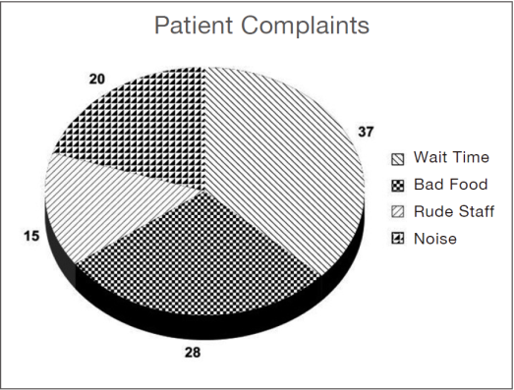
奠基篇 Unit 5
C
A
A
25. What was the man asked to do?
(A) Stay a few nights in the hospital
(B) Do a survey of patient complaints
(C) Improve the satisfaction of patients
(D) Perform food taste tests
26. What solution did the man have?
(A) Hire more employees
(B) Give patients more entertainment
(C) Extend the clinic hours
(D) Stop accepting complaints
27. Look at the graphic. Which complaint
will the speaker most likely tackle next?
(A) Bad food
(B) Rude staff
(C) Noise
(D) Small rooms

Slide 97
奠基篇 Unit 5
Audio Transcripts
Questions 25-27 refer to the following talk and chart.
Good morning, everyone. My name is Everett Sutter and I’m with Jusk Consulting. I’d like to thank Confederated Health Group for giving me an opportunity to work with your amazing company. I’ve been asked to review the patient-submitted complaints over the last year and formulate a strategy. As you can see from the graph, wait times are the number one complaint, so we will start there and go down the list. Although this is the top complaint for most hospitals, your hospitals seem to have a higher-than-average amount of complaints about this issue. I’ve recommended to the hospital administrators to increase staffing during peak hours by adding 125 new part-time nurses.
• formulate (v.) 想出（計畫等）
• administrator (n.) 管理人
• peak (adj.) 高峰的

Slide 98
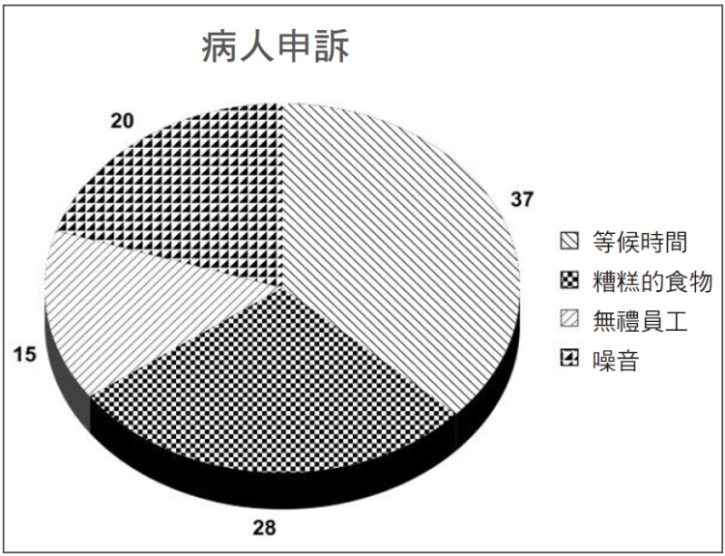
奠基篇 Unit 5
中文翻譯
大家早。我是朱斯科顧問公司的艾佛略‧沙特。我要感謝健康聯盟集團給我機會替你們這麼傑出的公司工作。我被要求檢視過去一年病人提出的申訴，並提出解決方案。如你們在圖表上所見，第一名的申訴是有關等候時間，所以我們將從那裡著手，再依序處理表上的其他問題。雖然這是大多數醫院所面臨的最主要申訴，貴醫院似乎在這個問題上有超出平均值的申訴數量。我已經向醫院的管理階層建議在尖峰時間增加工作人員，要有一百二十五位兼職的新護士。

Slide 99
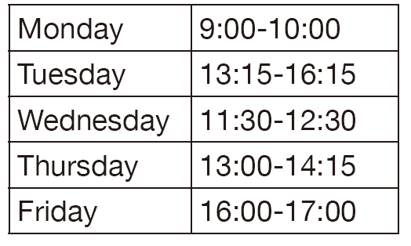
奠基篇 Unit 5
A
D
B
28. What was the purpose of Mike’s voice-mail message?
(A) To offer employment
(B) To discuss a problem with an employee
(C) To ask for Janice’s e-mail address
(D) To invite Janice on a date
29. When Mike says James “can give you the
inside scoop,” what does he mean?
(A) James will treat her to ice cream.
(B) James will interview her indoors.
(C) James will show her where her office is.
(D) James will tell her more detailed information.
30. Based on the graphic and the message,
what is the correct time like and James
will be available on Thursday?
(A) 1:00 p.m.
(B) 1:15 p.m.
(C) 1:30 p.m.
(D) 1:45 p.m.

Slide 100
奠基篇 Unit 5
Audio Transcripts
Questions 28-30 refer to the following voice-mail message and schedule.
Hey Janice, it’s Mike from Scott’s Sporting Goods. I . . . uhh . . . suppose I called at a bad time, but I wanted to let you know that, following our interview, I think you’d make a great addition over here at headquarters. I’d like to arrange a follow-up meeting to introduce you to our marketing director, James, so he //can give you the inside scoop// on the marketing coordinator position. I sent you an e-mail with a schedule of when James and I are free next week, so let me know which time slot is best for you. Oh! I almost forgot . . . I made a small mistake . . . I wrote in the e-mail that we are free at 1:00 p.m. on Thursday, but actually we won’t be available until a quarter past. Well, talk to you soon. Goodbye.
• addition (n.) 增加的人（或物） •coordinator (n.) 協調者

Slide 101
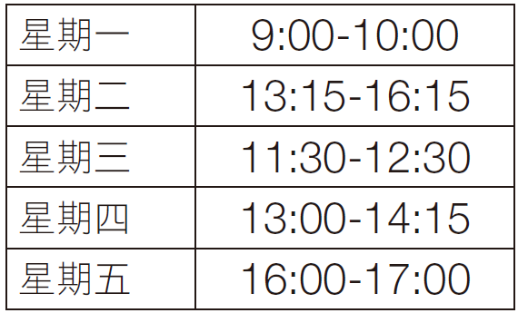
奠基篇 Unit 5
中文翻譯
嘿，珍妮絲，我是史考特運動用品店的麥克。我……呃……我想我打來的時機不好，但我想讓妳知道經過上次的面試之後，我認為妳在總部這裡會是個很棒的新增人手。我想要安排後續的會面，把妳介紹給我們的行銷總監詹姆士，他會給妳關於行銷專員職位的內部資訊。我寄了一封電子郵件給妳，裡面有詹姆士和我下星期何時有空的時間表，所以讓我知道哪個時段對妳而言最方便。噢！我差點忘了……我犯了個小錯誤……我在電子郵件裡寫我們在星期四下午一點有空，但其實我們要到一點十五分才有空。那麼，見面再談囉。再見。

Slide 102
奠基篇 Unit 5
Part 4 簡短獨白
-The End-

